Slide 1
Hosting a Static Website on Amazon S3
Presented by: Chinwuba Chidubem

Slide 2
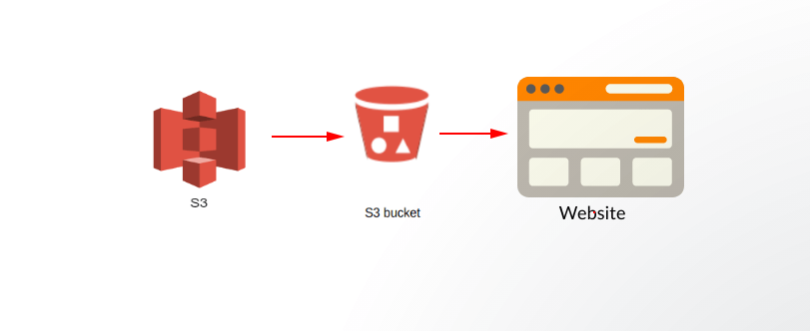
ARCHITECTURE

Slide 3
OUTLINE
CREATE S3 BUCKET
UPLOAD OBJECT IN S3
MODIFY PERMISSIONS
MODIFY BUCKET POLICY
STATIC WEBSITE HOSTING
BUCKET VERSIONING

Slide 4
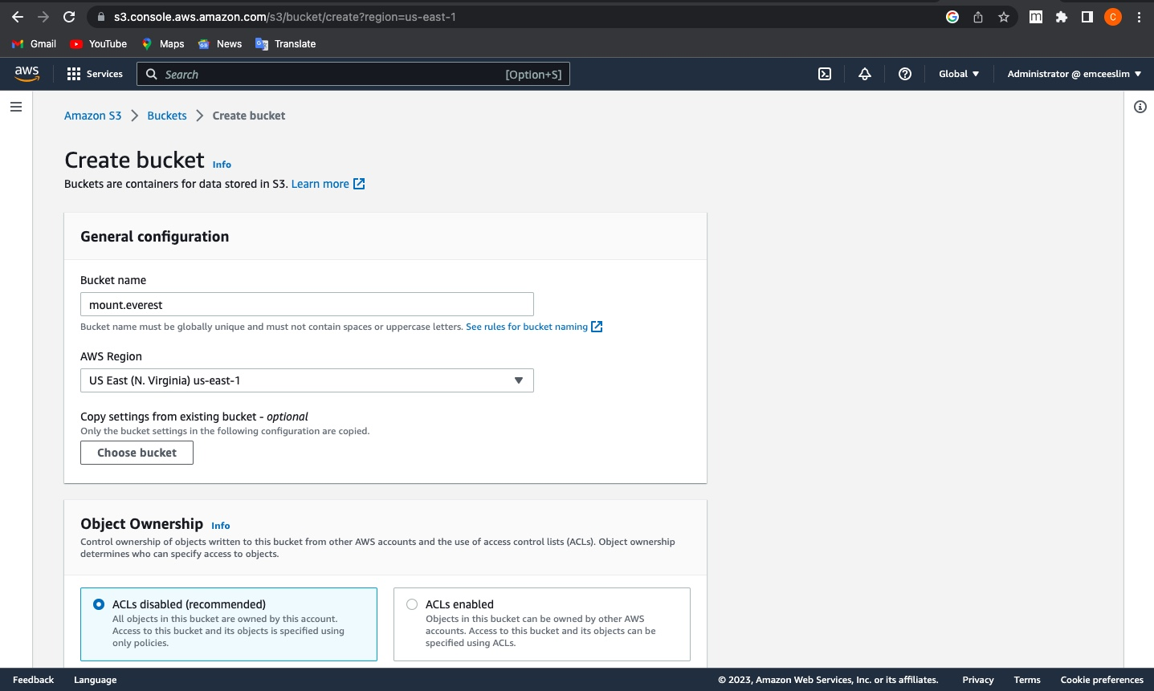
CREATE BUCKET

Slide 5
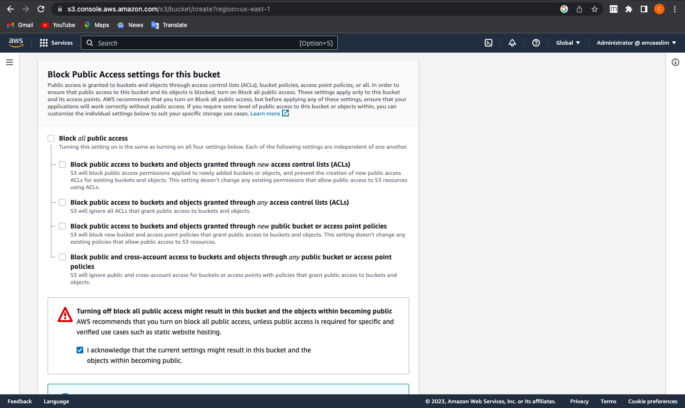
Turn off blocking off public access

Slide 6
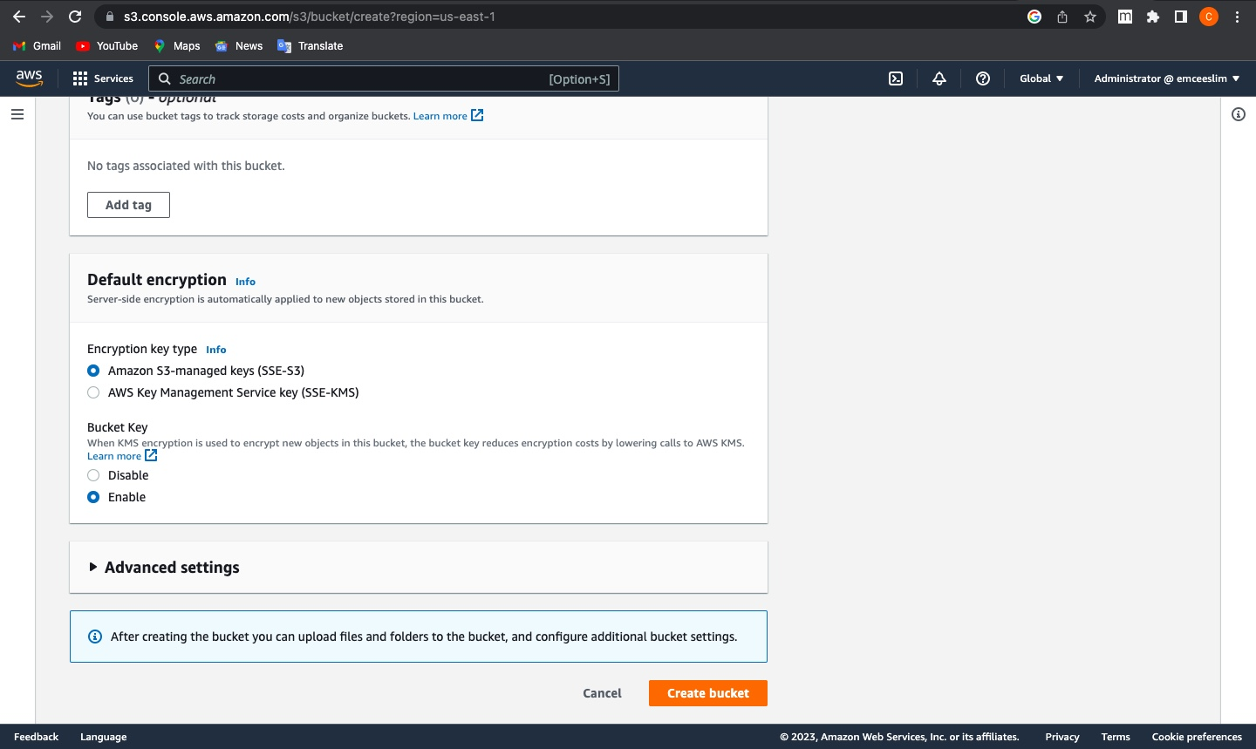
Enable Bucket Versioning

Slide 7
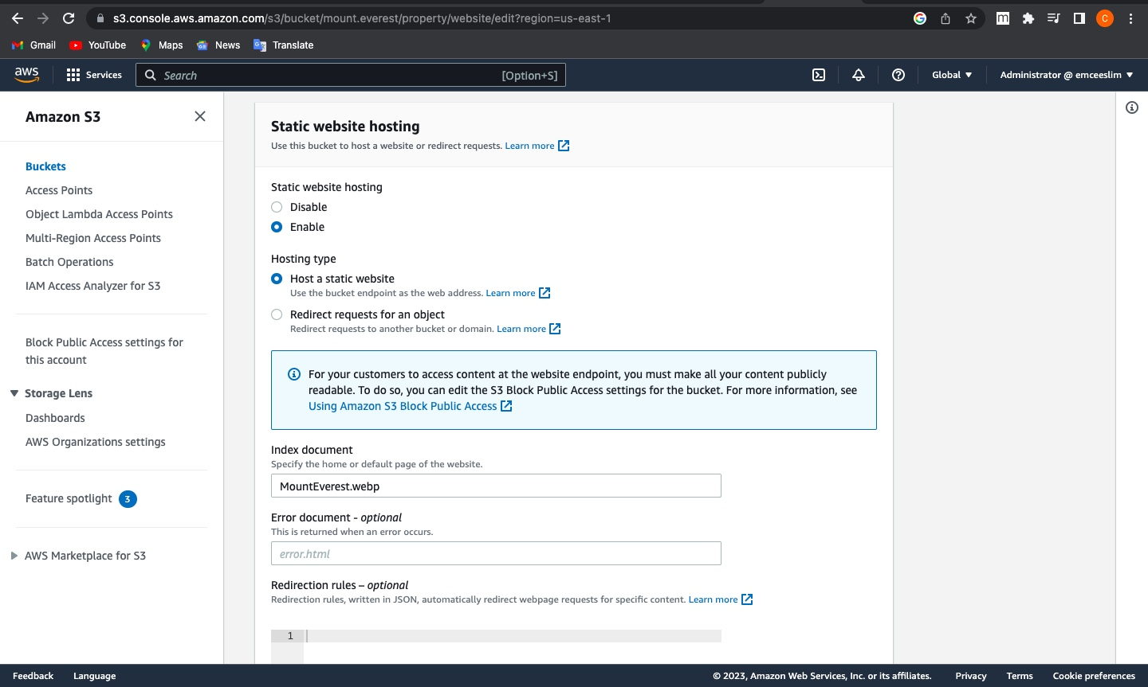
Enable Static Website Hosting

Slide 8
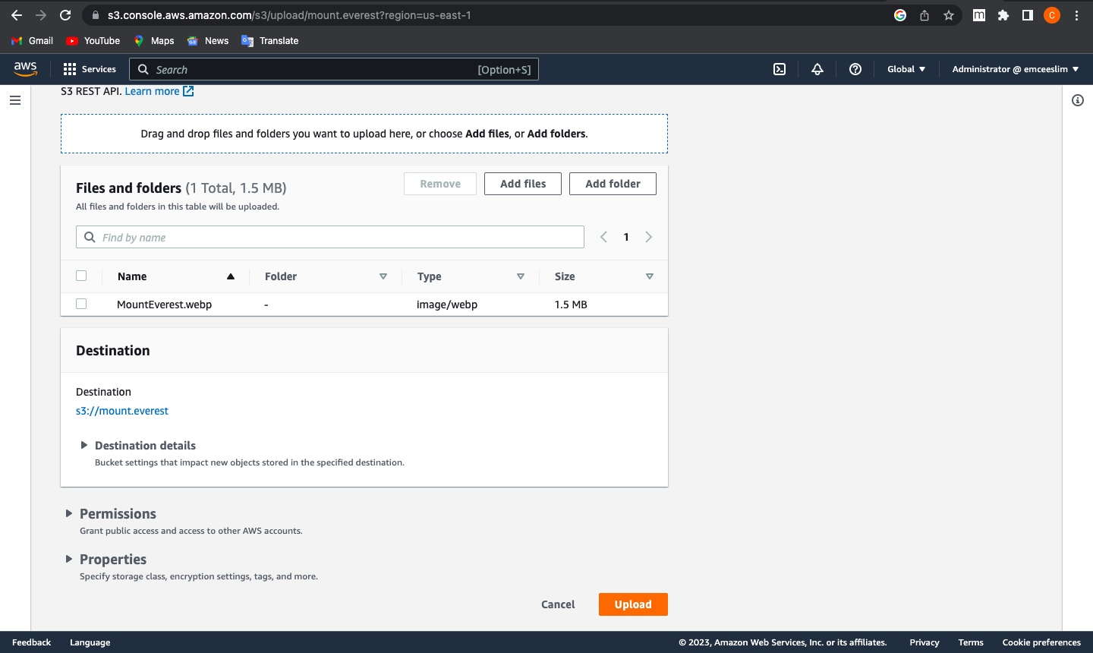
Upload File

Slide 9
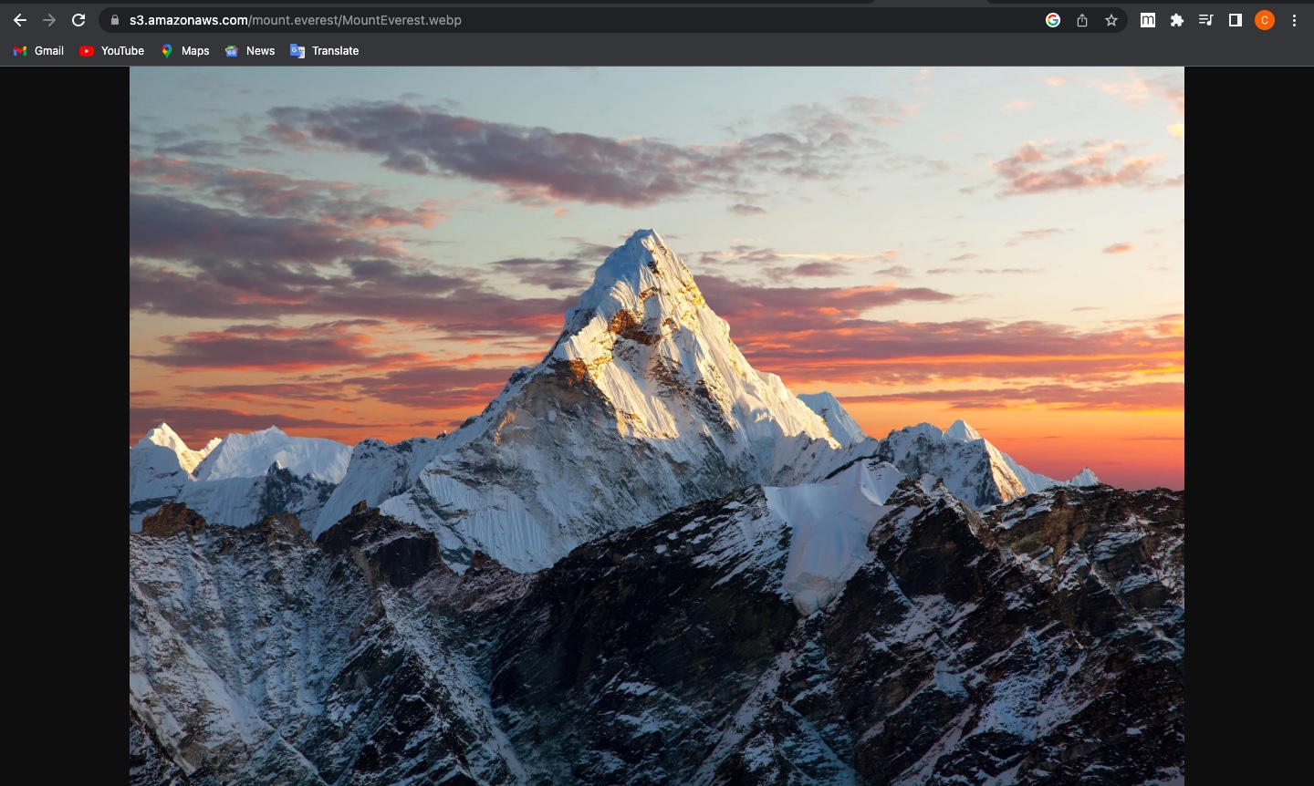
Accessing Website Internally

Slide 10
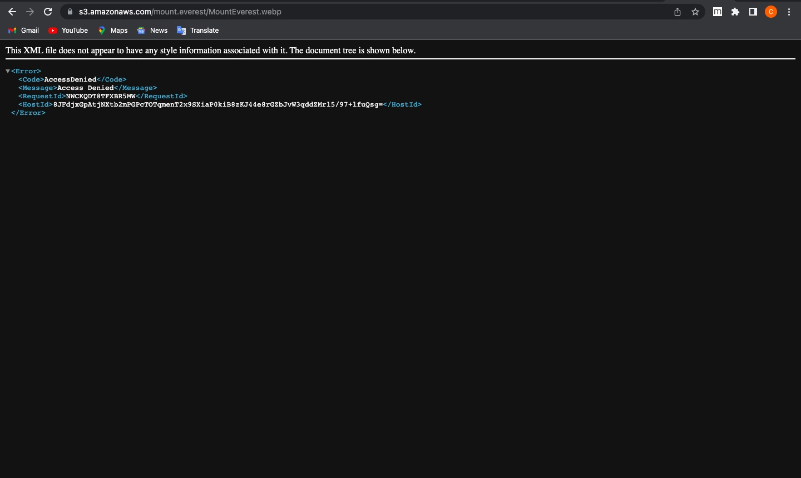
Acessing Website Externally

Slide 11
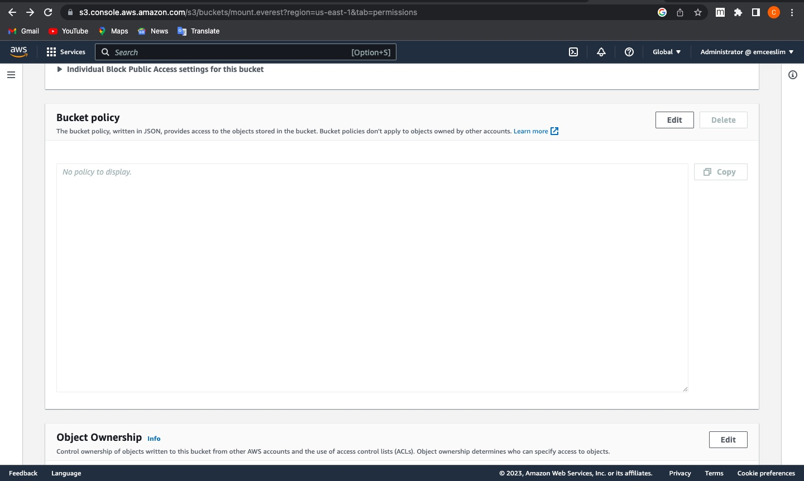
Generating Bucket Policy

Slide 12
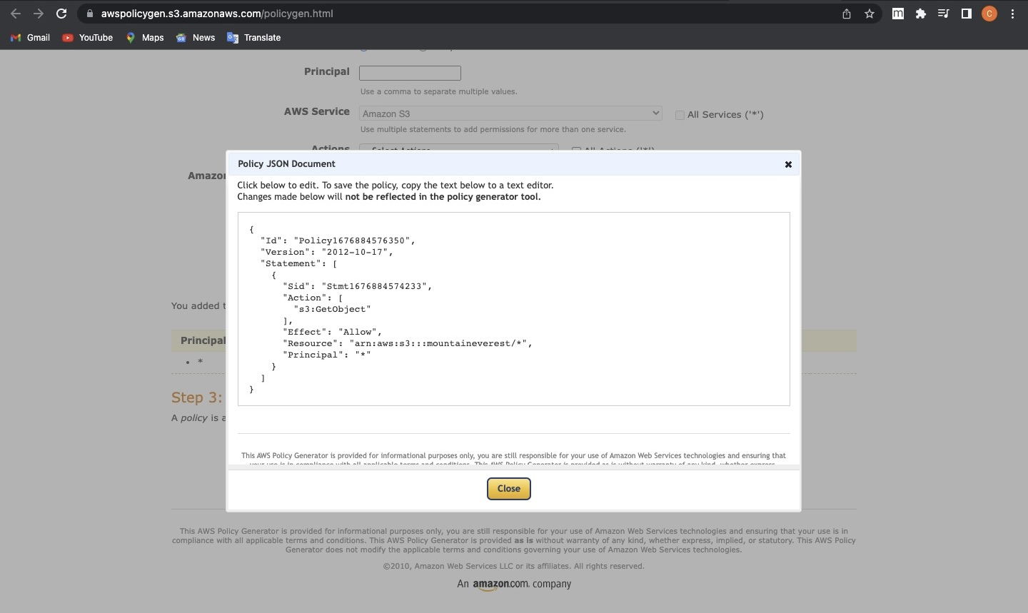
Policy Generation Continuation

Slide 13
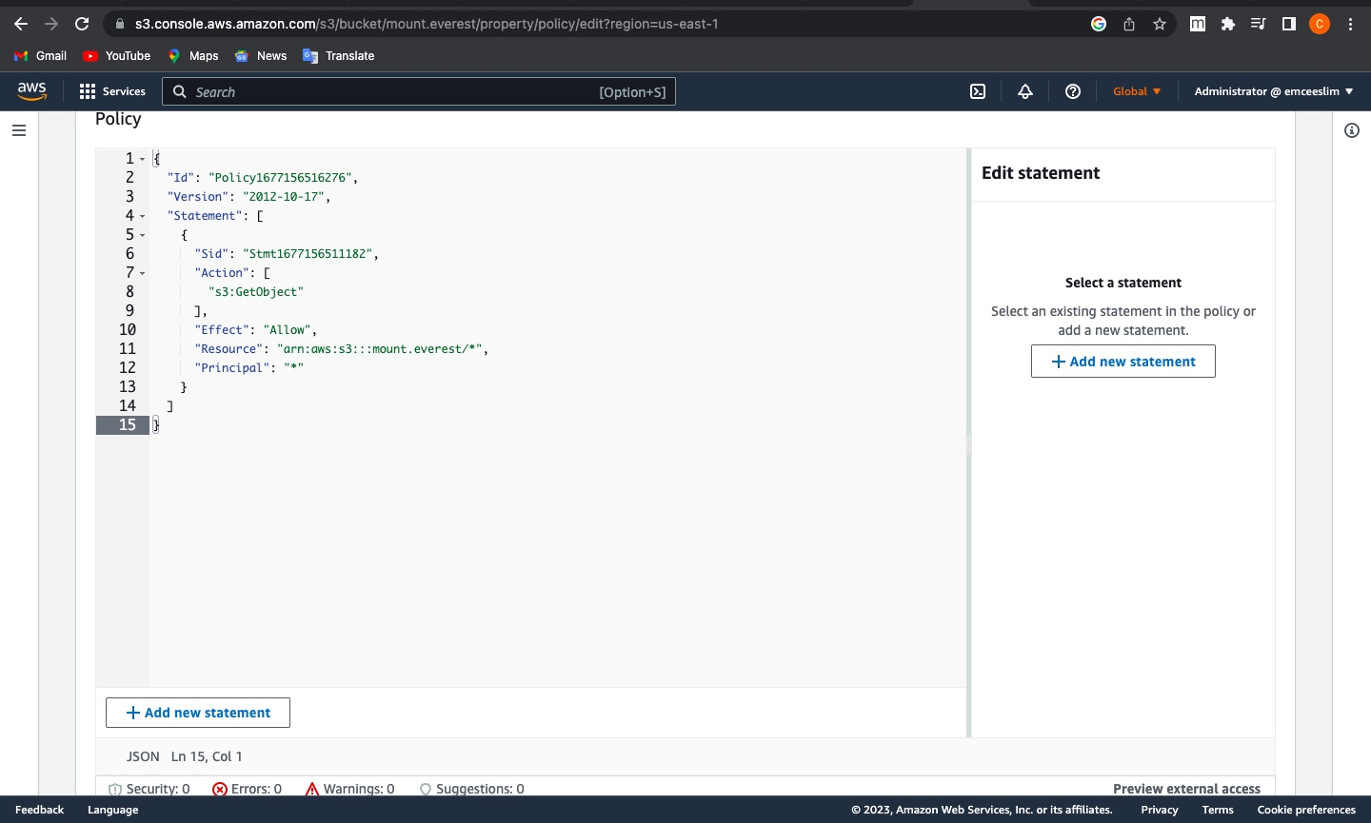
Policy Generation Continuation

Slide 14

Hosting the website externally

